Slide 1
5 Keys To Successfully Managing Any Dealership
Mark Tewart
President, Tewart Enterprises Inc
#CBTConference
@CarBizToday

Slide 2
5 Measures Of A Manager
#1 - Attracts & Selects The Right Team
#2 - Creates Clearly Communicated Expectations
#3 - Educates
#4 - Motivates
#5 - Holds Accountable

Slide 3
Attracting & Selecting
Culture & Environment
Wants vs. Needs
Create an “Ideal Employee Profile” for position
Ask your customers – (Email, Facebook, LinkedIn)
Be prepared – (Interview Questions, Profiles)
Reward referrals

Slide 4
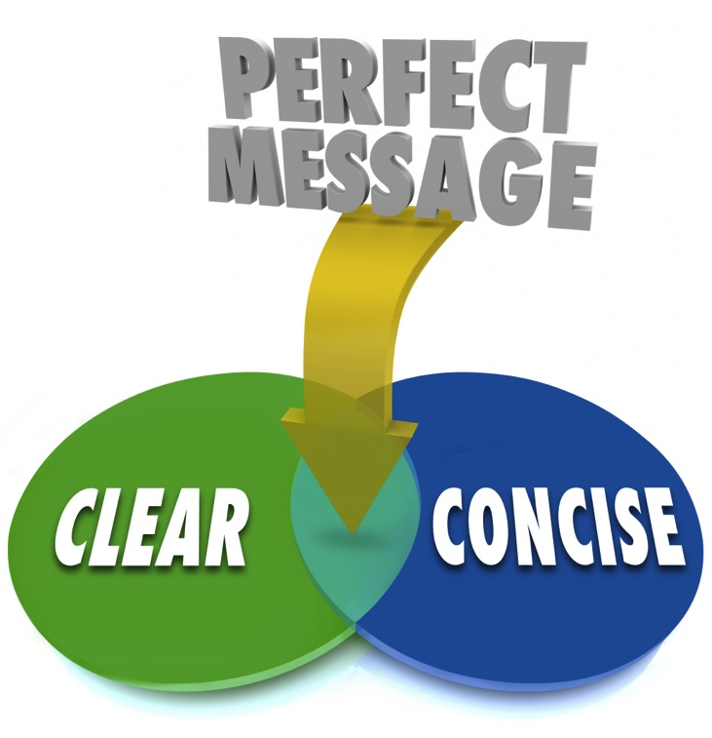
Clearly Communicate Expectations
Written & Verbal
Onboarding
Routing procedures
Black & White Issues
Ongoing / Never-ending
Review / Preview
Save-A-Deal
Coaching
Fail-Safe Systems

Slide 5
Educate
Continual
Calendar
Utilize different modes
Sales Skills, People Skills, Life Skills, Marketing Skills
Look for “Teachable Spirits”

Slide 6
Motivate
85/10/5 Rule
Utilize outside resources
Daily interactions – Take notice
Find their “why”
Cut the cancer

Slide 7
Hold Accountable
“Coach, Counsel, Cut”
“Now Management”
Eliminate “Passive-Aggressive” Management
Set Tolerations

Slide 8
Outcome Based Management
Four Desired Outcomes:
1. Profit
2. Productivity
3. Retention
4. Customer Service

Slide 9
Measuring The Workplace – Part 1
Twelve Questions
1. Do I know the expectations?
2. Do I have what I need?
3. Do I have opportunity?
4. Have I received recognition?

Slide 10
Measuring The Workplace – Part 2
5. Does my supervisor care?
6. Encourages my development?
7. Opinions count?
8. Does the purpose make me important?

Slide 11
Measuring The Workplace – Part 3
9. Are my co-workers committed to quality?
10. Do I have a best friend at work?
11. Has the leader talked to me about my progress?
12. Opportunities to learn?

Slide 12
The Most Influential Questions
Questions that Most Affect the Four Desired Outcomes:
1. Do I know what is expected?
2. Do I have the what I need?
3. Do I have the opportunity?
4. Received recognition?
5. Does someone care about me?
6. Encourages my development?
Rank each Question from 1 to 5 (5 being strongly agree).

Slide 13
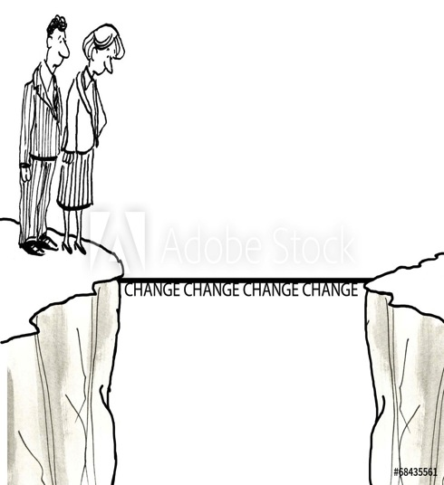
Immutable Laws OF Human Behavior
1. People don't change that much.
2. Don't focus on weaknesses
3. Grow people’s talents
4. Don't confuse talent with skills.
Catalyst – “An agent of change”

Slide 14
Maximizing Competencies
1. Select for talent and attitude.
2.Train for Skills.
3. Don't confuse skills and knowledge for talent.
4. Set expectations for results, not just steps.
5. Work towards strengths, not weaknesses.
6. Talent is recurring patterns of thoughts, feelings and behaviors.

Slide 15
Motivating People For Results
1) Pleasure vs. Pain Principle
2) Pattern recognition
3) Working towards a greater purpose
4) Team oriented goals
5) Individual goals
6) Clear communicated expectations of their actions & overall job
7) Monetary goals that are connected to the end result

Slide 16
Managing vs. Coaching
The Coaching Approach:
1) Coach people to solve their own problems.
2) Coach people to achieve their own goals.
3) Managers tend to make their employees addicted to them.
4) Creating addicted employees gives managers a misguided sense of importance.
5) Begin to coach people more than manage the process.

Slide 17
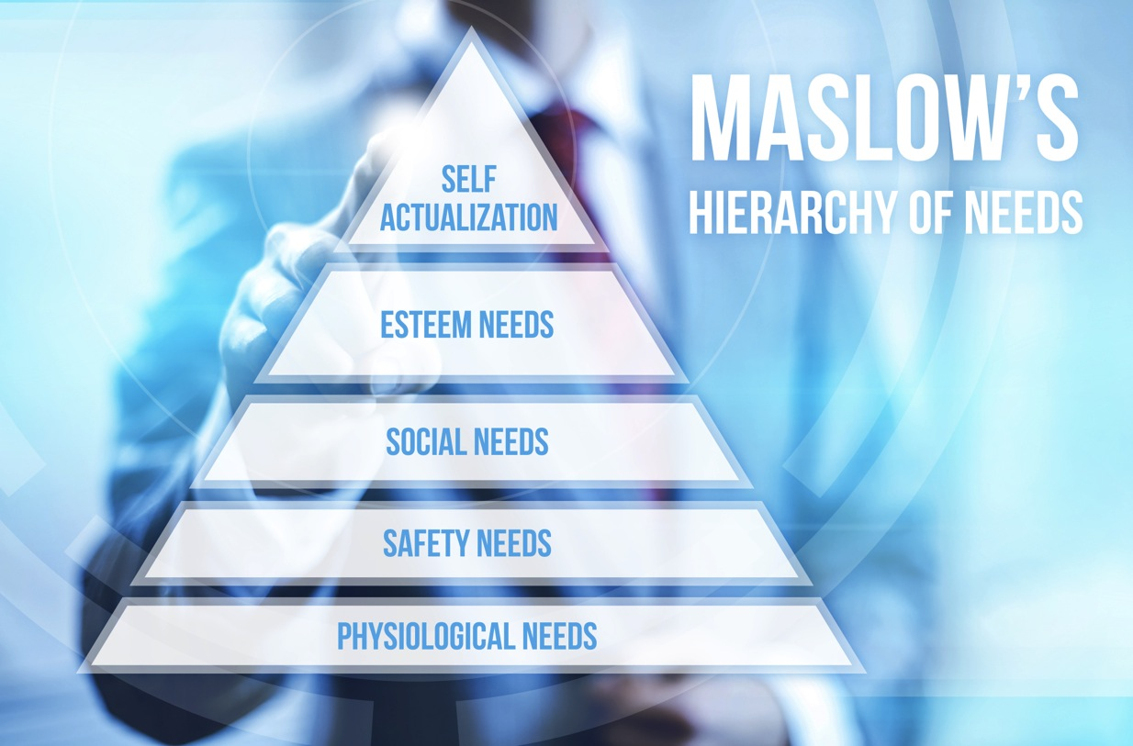
Maslow’s Hierarchy

Slide 18
Manager Time Analysis
Most to Least Productive Employees Most to Least Time Spent
1. ___________________________ 1. ___________________________
2. ___________________________ 2. ___________________________
3. ___________________________ 3. ___________________________
4. ___________________________ 4. ___________________________
5. ___________________________ 5. ___________________________
6. ___________________________ 6. ___________________________
7. ___________________________ 7. ___________________________
8. ___________________________ 8. ___________________________
9. ___________________________ 9. ___________________________
10. __________________________ 10. __________________________

Slide 19
Manager Time Analysis #2
Rank from Most to Least Where You Spend Your Time
1. Working Deals _____ _____
2. Product _____ _____
3. Administrative _____ _____
4. Heat _____ _____
5. Advertising/Marketing _____ _____
6. Education/Training _____ _____
7. One on One Coaching _____ _____
8. Emergencies _____ _____
9. Recruiting _____ _____
10. Other _____ _____
If you could change this what would be a more desirable order? (Put answers in second lines provided)
What is your action plan for change?

Slide 21
FOR MORE INFORMATION
Mark Tewart
info@tewart.com
888 2 Tewart (888 283-9278)
Twitter - @marktewart
Facebook marktewartfanpage
Instagram – marktewart
LinkedIn - marktewart

